Slide 1

Bank Churn Analysis
April 2023

Slide 2

Agenda
Introduction
Dataset Description
Data Analysis and Visualization
Research Questions
Conclusion

Slide 3

Introduction
Churn rate, sometimes known as attrition rate, is the rate at which customers stop doing business with a company over a given period of time.
Attrition in a company is usually measured with a metric called attrition rate or churn rate.
Understanding your customer churn is essential to evaluating the effectiveness of your marketing efforts and the overall satisfaction of your customers.
Four Ways to Reduce Customer Churn
Understand why customers churn.
Provide supporting resources and education.
Make sure you’re targeting the right audience for your products.
Know the signs that a customer is likely to leave.

Slide 4
Dataset Description
The dataset has 10127 rows and 19 columns.
The features data types consist of 13 integers and 6 objects.
Total 11 objects can be categorize into categorical data and 8 into continuous data.
Total 285 null values was found from different object.
 | CLIENTNUM | Attrition Flag | Customer Age | Gender | Dependent count | Education Level | Marital Status
Count | 10127 | 10127 | 10127 | 10034 | 10127 | 10127 | 10127
Unique | nan | 2 | nan | 2 | 6 | 7 | 3
Mode / Mean | nan | Existing Customer | 47 | Female | 3 | Graduate | Married
Null Value | 0 | 0 | 0 | 93 | 0 | 0 | 0

Slide 5
 | Income Category | Card Category | Months on book | Total Relationship Count | Months Inactive 12 month | Contacts Count 12 month
Count | 10127 | 9995 | 10127 | 10127 | 10127 | 10127
Unique | 5 | 4 | nan | 6 | 7 | 7
Mode/Mean | 40K | Blue | 36 | 3 | 3 | 3
Null Value | 0 | 132 | 0 | 0 | 0 | 0
 | Credit Limit | Total Revolving Bal | Avg Open To Buy | Total Trans Amt | Total Trans Ct | Avg Utilization Ratio
Count | 10067 | 10127 | 10127 | 10127 | 10127 | 10127
Unique | nan | nan | nan | nan | nan | nan
Mode/Mean | 8703.18 | 1162.81 | 7469.13 | 4404.08 | 64.85 | 0.27
Null Value | 60 | 0 | 0 | 0 | 0 | 0

Slide 6
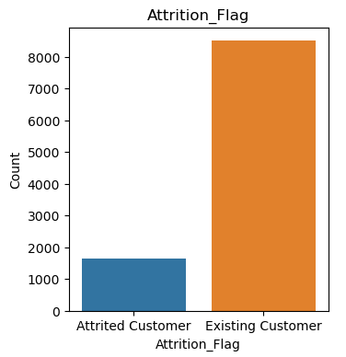
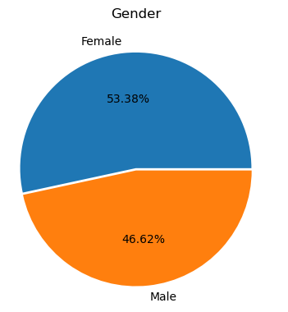
Data Analysis and Visualization
Univariate analysis
In the bank, there are 10127 customers. 1627 customers who compose 16.07% of the total number of customers left the bank for some reasons. Besides that, 8500 customers are currently with the bank.
Female customers are more in number, contributing to 46.62%

Slide 7
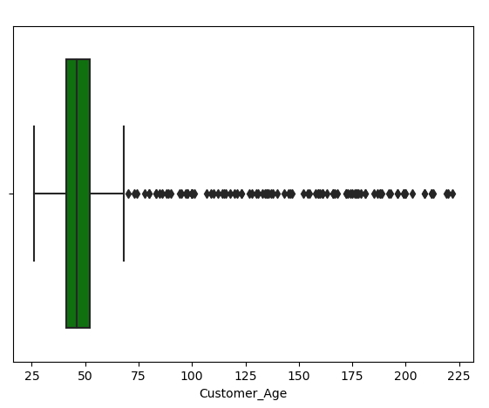
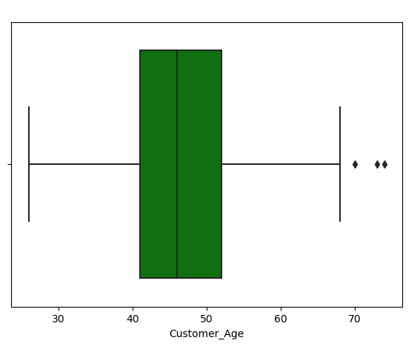
Outliers was found in age column. it is seen that it is very rare that someone have age more than 100 years. The analytics team decides to replace the ages greater than 80 with the average age of other customers.
Most likely, customer age follows the normal distribution. Most of the bank customers are in between 40 and 55 years of age.

Slide 8
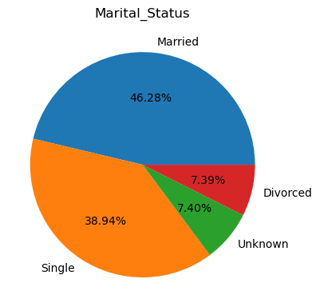
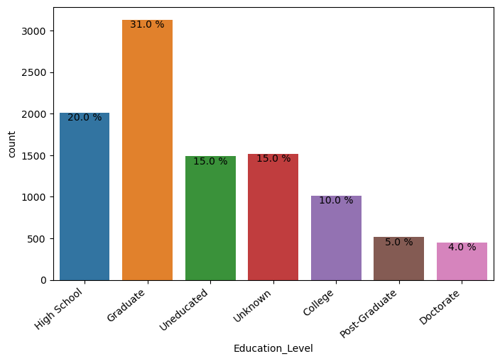
46.28% of the people are Married, 38.94% are Single and 7.39 % are Divorced.
The dataset indicates that most of the customers are Graduate belongs or have completed high school, which adds up to 51% of the total population.

Slide 9
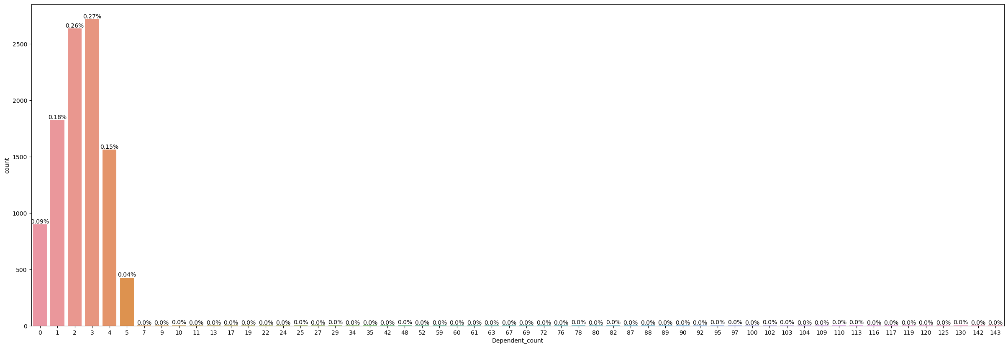
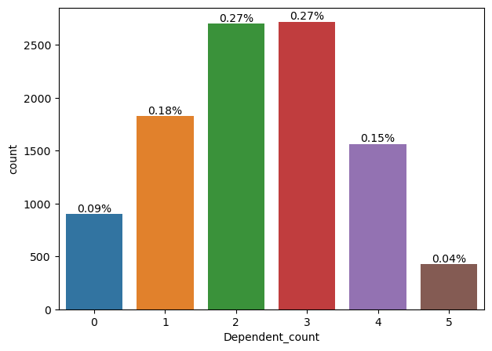
Dependent count is number of dependents on the card holder.
Some people are having many dependents on them. This could be a result of human error in data. Very few people are having more than 5 dependents. However, there are some cases where the dependent count is greater than 100, which is abnormal. Hence, data clearing might be required.
After clearing data, it is seen that card holders usually have 2 to 3 dependents on them which adds up to 54% of the total population.

Slide 10
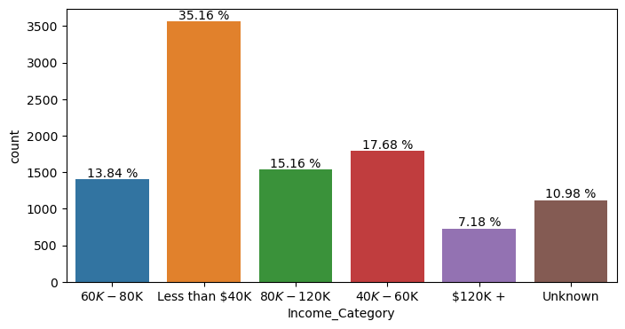
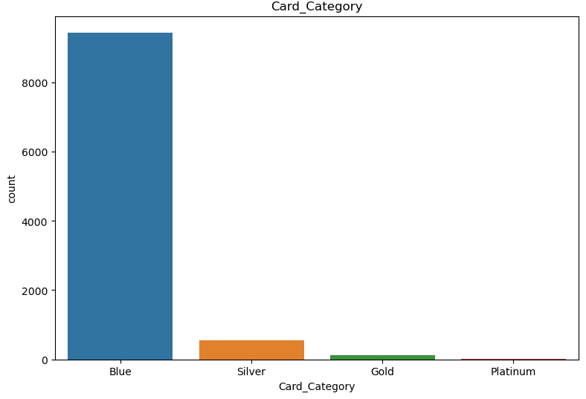
Majority of the population is earning less than 40k dollars.
93.29% of the population is using the Blue card followed by Silver. The Platinum card is sold the least.

Slide 11
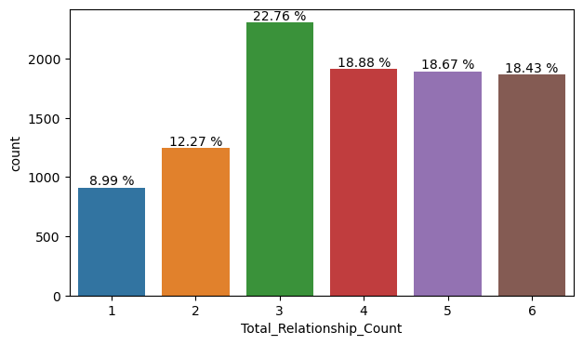
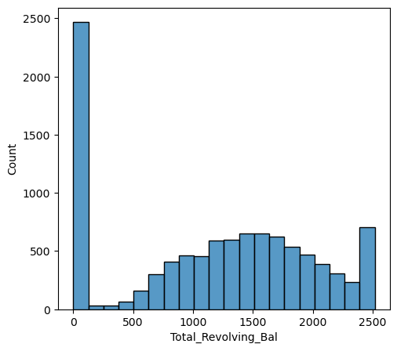
Usually people have three years of relationship with the bank. Then, there is a decline of 3%. Later, there is very little variation. Approximately 20% of the people tend to leave in their first two years.
There is a spike at the 0 Revolving Balance, which indicates the majority of people tend to have 0 Revolving Balance. Around 25% of the customers do not have a revolving balance, i.e. they settle the credit card bill within a month. Around 75% of customers do not pay the credit card balance on time. These are the profitable customers to the bank.

Slide 12
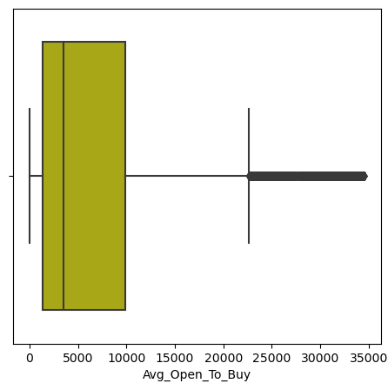
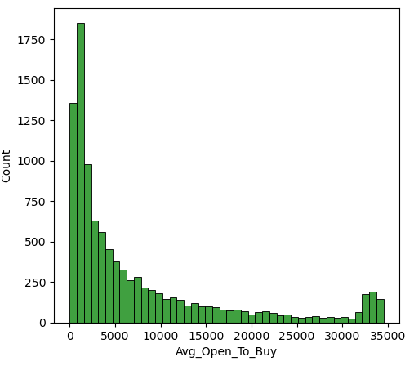
In average open to buy plot the strength of outliers is increasing at the end of the tail which indicates that outliers are not a human error but some people are showing behavior other than population.

Slide 13
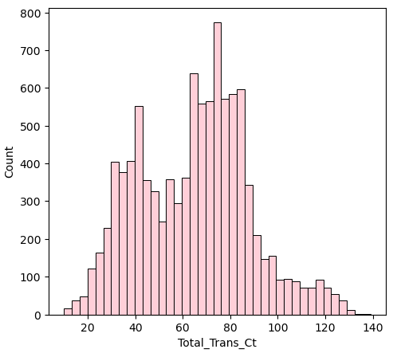
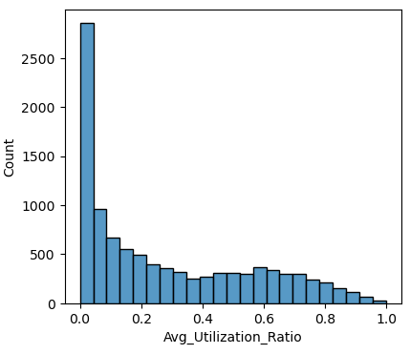
Majority of the customers are making more than 50 transactions.
Around 75% of the customers are having low utilization (less than 0.5 utilization)

Slide 14
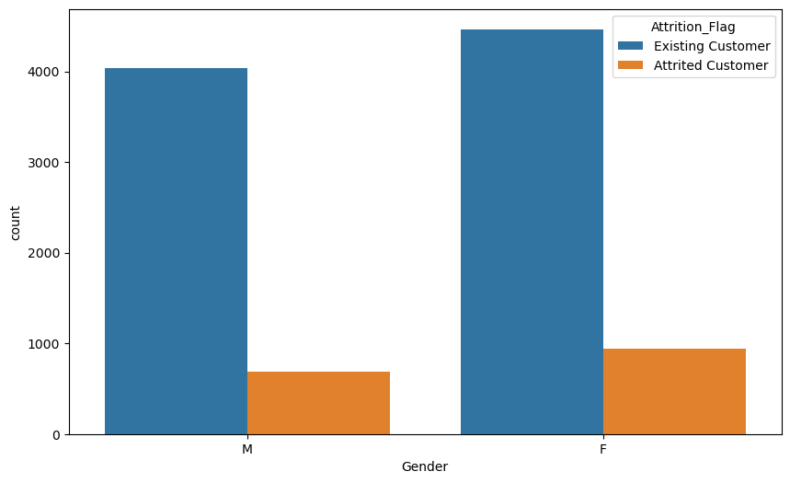
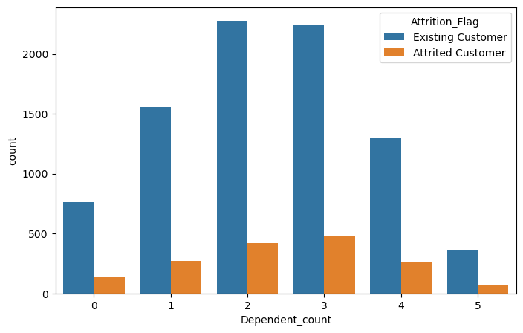
Bi-Variate Analysis
Percentage of women getting churned out is more than men.
Customers who are attrited or existing have a maximum of 2 to 3 dependents on them.

Slide 15
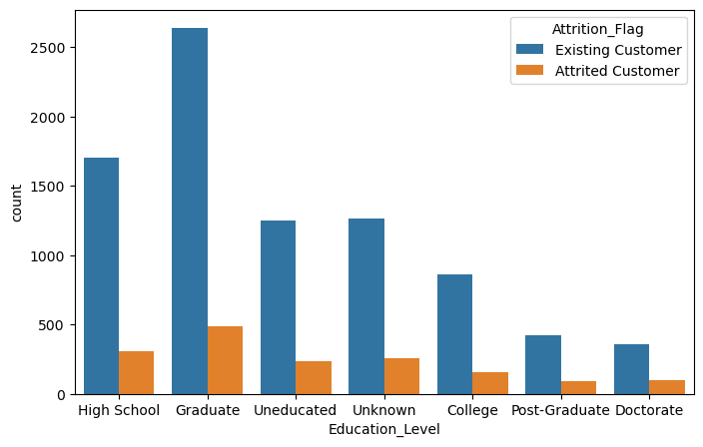
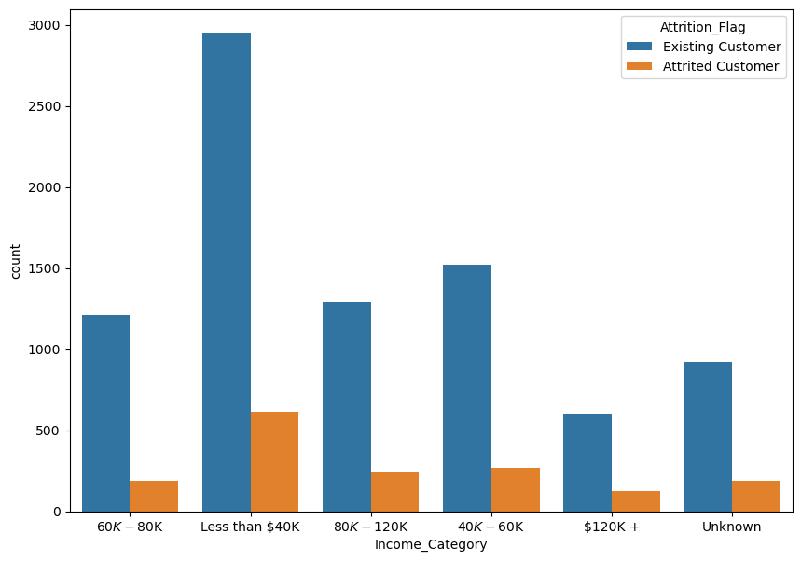
Graduate and High School customers have a higher Attrition rate compared to another education level.
Almost 20-30% of customers who attrited are earning less than 40,000 dollars.

Slide 16
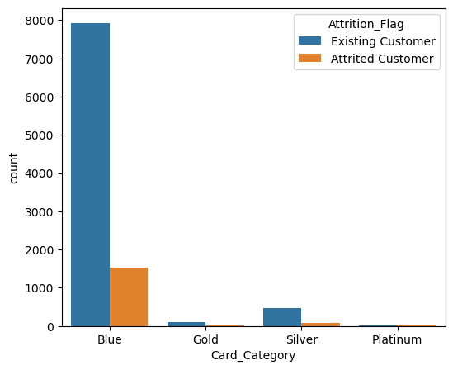
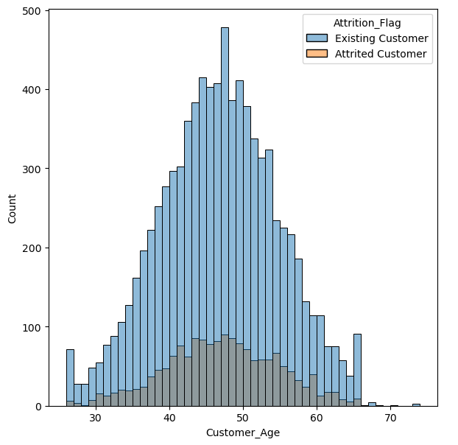
Majority of the customers are churning from the blue card category. It is also to be noted that the maximum customers are also blue card holders.
Most of the bank customers who left the card service are between 40 to 50 years of age.

Slide 17
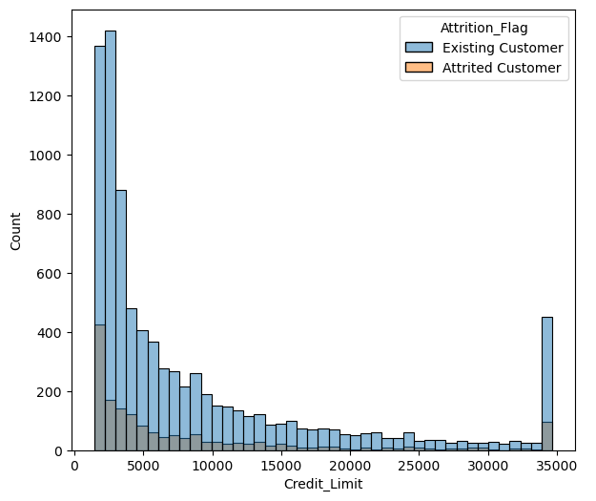
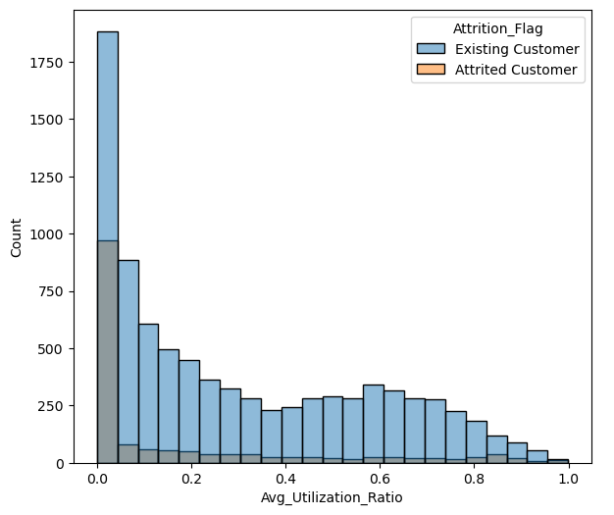
Customers whose credit limit is less than 5000 dollars churned most.
Customers who churned have very low usage. Most of them haven't used their cards. Around 75% of customers who churned have usage only of only 0.2%.

Slide 18
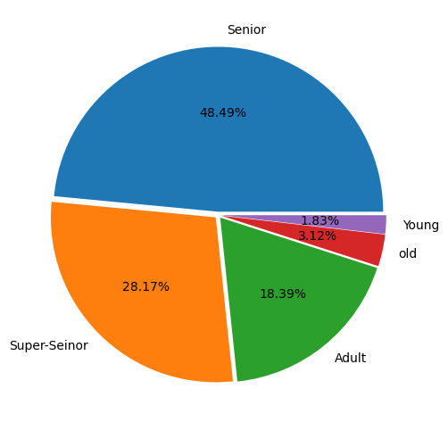
Research Questions
Which age group of women has a larger churn?
In 40-50 Senior age group's attrition number is the highest comparing to other age groups. In this age group, we have 48.49 % of customer attrition.
50-60 Super Senior age group, are more likely to leave the card. Their attrition proportion to their age group is approximately 28.17%
30-40 Adult age group has 18.39% attrition.
Young group generally stay.

Slide 19
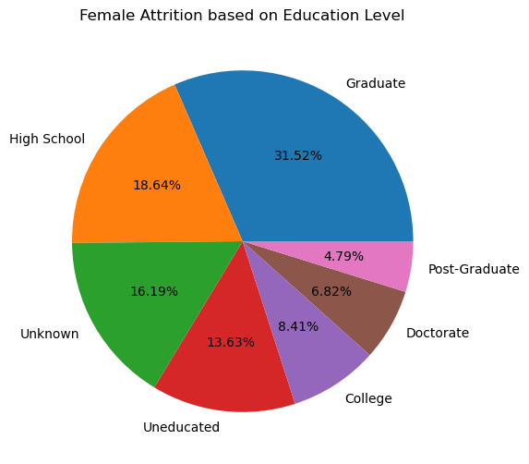
Analyze the churn of women customers based on their education levels?
Women's who are graduate have the most attrition number which makes up the 31.52 % of all attrition.
High school level has the second highest attrition number which makes up the 18.64% of all attrition
Besides that, unknown and undereducated are mostly affected by the attrition respectively. Their approximately 29-30% women's left the bank facility.

Slide 20
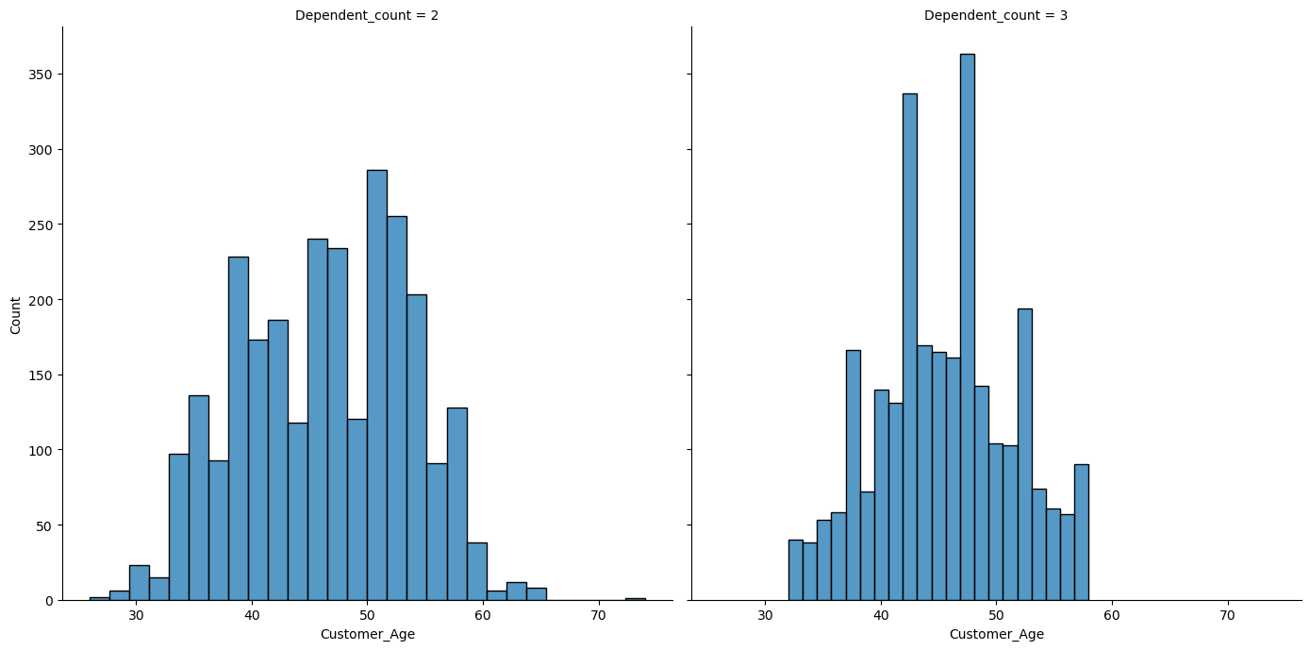
Age-wise analysis of the customers whose dependent count is 2 or 3 (Existing and Churned out)
Most of the customers have the same age distribution based on their dependent counts.

Slide 21
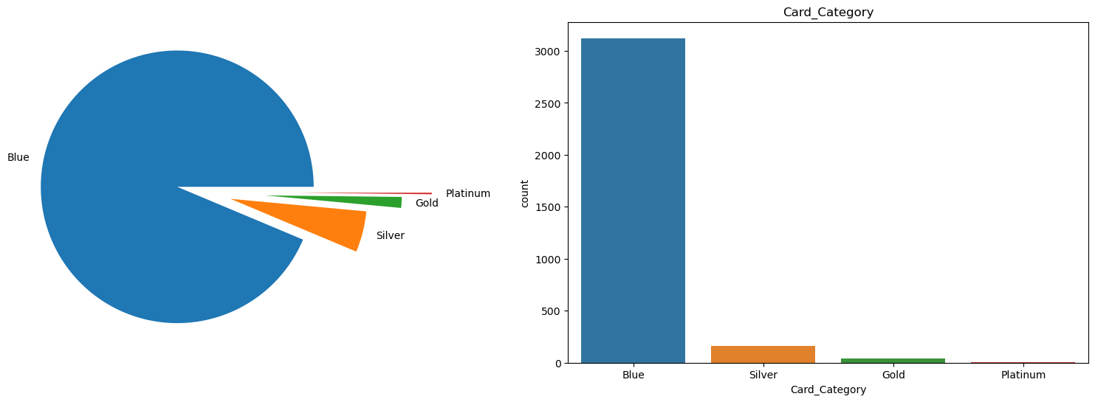
Card category wise analysis of customers who are high school pass outs and churned out
Majority of the population is using the Blue card followed by Silver. The Platinum card is sold the least.

Slide 22
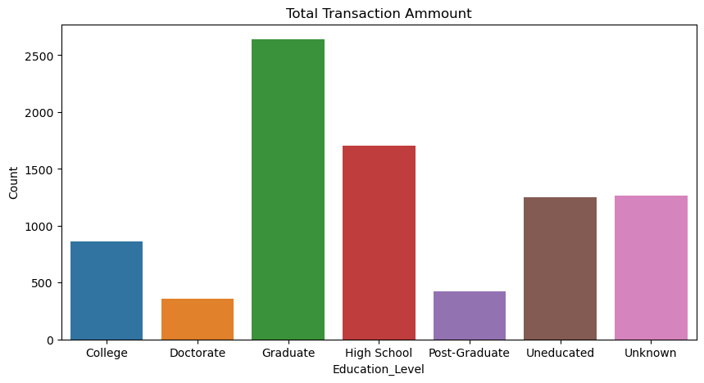
Present the details of Total Transaction Amount of existing customers who are high school pass outs.
Total transaction Amount of existing customers who are high school pass outs is 1707

Slide 23
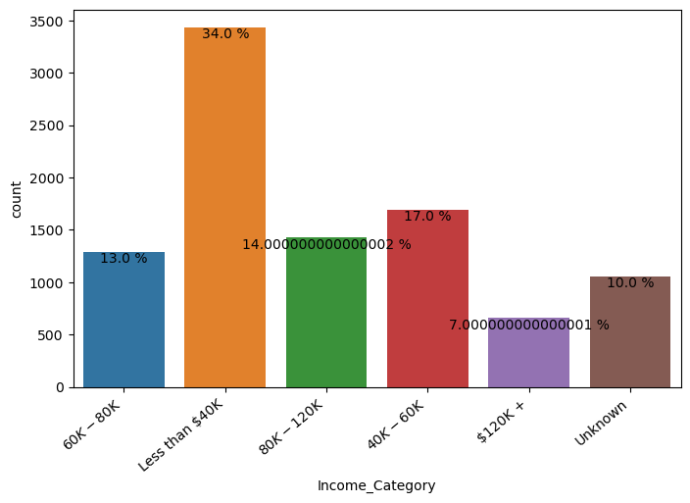
Analysis of the churned out customers who hold the blue card with respect to their income categories.
Customers who have an income less than 40000 dollars have higher attrition rate. Contributes 34 % of total attrition.
Customers having income range between 40 to 60 k have second highest attrition.
According to graph it is clearly seen that more the income less the attrition rate and vice versa.

Slide 24
Conclusion
Women's at higher attrition risk comparatively than males.
Most of the attrited customers have dependent count 2 or 3.
Graduate and High School customers have a higher Attrition rate compared to another education level. Bank should give more information and knowledge about the card to this customers.
Customers who have an income less than 40000 dollars have higher attrition rate. Generally peoples spend less if there income is less.
It has been seen that the maximum customers who churned have blue card. And also their average utilization score is 0.2 which is very less. Bank should give more offer on blue card so that customer start spending.
Customers whose have credit limit less than 5000 churned most. May be they spend but their credit limit wont be increase and that’s why they may leave.

Slide 25
Thank You

